Slide 1
Welcome to CRPS Treasurer’s Reporting for Lodges and Associations

Slide 2
Treasurer’s Role and Duties
1. Member of your Lodge or Association’s Executive committee.
2. Take care of your Lodge or Association finances.

Slide 3
Keeping our members informed
As Treasurer you are required to present your report monthly. If your lodge or association has more than one business meeting a month than you may be required to report more often.
A Treasurer’s report should include all receipts, all expenditures, as well as the bank balances
The goal is to keep all our members informed

Slide 4
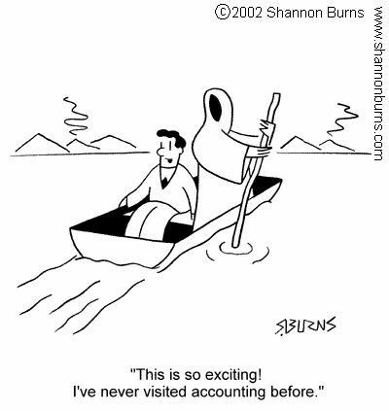

Slide 5
Using a spreadsheet
Excel is a spreadsheet program on Microsoft Office. It comes with the Word program. If you do not have access to this program this information can all be entered in a manual ledger or any other spreadsheet program.
Excel lets you enter numbers, names, dates in a column and row format. You can have your columns automatically total with the autosum feature.

Slide 6
Sample of Accounting
CANADIAN ROYAL PURPLE EXAMPLE ACCOUNTING |  |  | Accounting Jan 1, 2020 to Dec 31, 2020
 | Budget | Total | Jan | Feb | Mar | Apr
Revenue
Catering | $ 6,000.00 | $ 3,338.00 | $ 2,038.00 |  | $ 1,300.00
Membership Dues | $ 1,740.00 | $ 1,740.00 | $ 1,740.00 |  | $ -
Sunshine March | $ 100.00 | $ 40.70 | $ 13.70 |  | $ 27.00
Misc | $ - | $ -
Total | $ 7,840.00 | $ 5,118.70 | $ 3,791.70 | $ - | $ 1,327.00 | $ -
Expenses
Donations | $ 3,000.00 | $ 350.00 |  | $ 300.00 | $ 50.00
Member Expenses | $ 500.00 | $ 136.86 | $ 136.86
Catering Expenses | $ 3,500.00 | $ 1,978.48 | $ 1,389.02 |  | $ 589.46
Supplies | $ 200.00 | $ 101.03 | $ 101.03
National Memebership | $ 1,740.00 | $ 1,740.00 | $ 1,740.00
Lodge Dues | $ 25.00 | $ 25.00 | $ 25.00
Lodge Insurance | $ 158.00 | $ 158.00 | $ 158.00
Advertising | $ 100.00 | $ -
Bank Charges | $ 40.00
Total. | $ 9,263.00 | $ 4,489.37 | $ 3,549.91 | $ 300.00 | $ 639.46 | $ -
GENERAL BANK ACCOUNT BALANCE
January Opening | $ 5,000.00
February | $ 5,241.79
March | $ 4,941.79
April | $ 5,629.33
Excel Spreadsheet available to customize
Easy to use

Slide 7
Monthly Detail on Excel spreadsheet
Jan-20
REVENUE |  |  | Catering | Dues | Sunshine
Sandi Lougheed |  |  | $ 346.00
All members |  |  |  | $ 1,740.00 | $ 13.70
MaryLou McCarthy |  |  | $ 1,692.00
 |  |  | $ 2,038.00 | $ 1,740.00 | $ 13.70 | $ 3,791.70
EXPENSES | Chq # |  | Groceries | Supplies | Members | Nat Dues | Lodge Dues
ABC Grocery | 1511 | $ 147.71 | $ 147.71
Meat Store | 1512 | $ 696.92 | $ 696.92
DEF Grocery | 1513 | $ 432.48 | $ 432.48
Jan Gammie | 1514 | $ 65.93 | $ 65.93
Lynda Nolan | 1515 | $ 66.14 |  | $ 66.14
Anita Kitz | 1516 | $ 117.73 | $ 45.98 | $ 34.89 | $ 36.86
CRPS | 1517 | $ 1,765.00 |  |  |  | $ 1,740.00 | $ 25.00
Jim Matthews | 1518 | $ 100.00 |  |  | $ 100.00
 |  | $ 3,391.91 | $ 1,389.02 | $ 101.03 | $ 136.86 | $ 1,740.00 | $ 25.00
Feb-20
EXPENSES
M. McDonald |  |  | Donation
Encounters of Cananda | 1519 |  | $ 300.00
Mar-20
REVENUE |  |  | Catering | Sunshine | Dues
Smith Lunch |  |  | $ 200.00
Jones Funeral |  |  | $ 1,100.00
 |  |  |  | $ 27.00 | $ 35.00
Total |  | $ 1,300.00 | $ 1,300.00
EXPENSES |  |  | Groceries | Donations
Carrie Stotz | 1520 | $ 287.22 | $ 287.22
BDSS | 1521 | $ 50.00 |  | $ 50.00
Jan Gammie | 1522 | $ 15.00 | $ 15.00
ABC Grocery | 1523 | $ 116.57 | $ 116.57
DEF Grocery | 1524 | $ 75.94 | $ 75.94
Meat Store | 1525 | $ 94.73 | $ 94.73
 |  | $ 639.46 | $ 589.46 | $ 50.00
This is to track the detail of your banking on a monthly basis.

Slide 8
Benefits of a Spreadsheet
An Excel Spreadsheet is a wonderful way to keep track of your Lodge or Association’s financial records
A spreadsheet can be customized in many different ways to work for your Lodge or Association
Using the autosum feature will ensure that you never produce an unbalanced statement

Slide 9
A Simple but Effective Report
If you are producing printed reports every month a spreadsheet can become a little cumbersome.
A simple but effective report is a Cash Flow Statement
This report will give you your opening balance, a listing of all monies received, a listing of all monies spent, as well as your up to date bank balances
A Cash Flow Statement is very easy to read

Slide 10
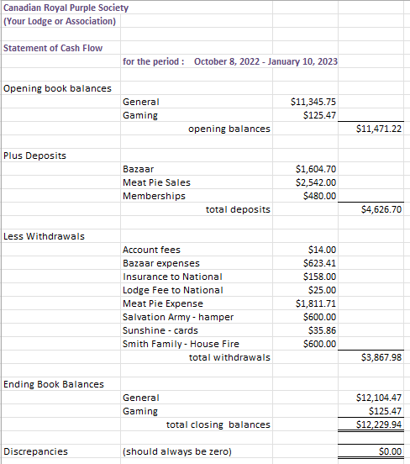
Sample of Cash Flow Statement
Easy to use
Easy to read

Slide 11
Thank you so much for attending!
Any questions or comments?

